Slide 1


Database System [Mapping Constraints in DBMS]

Slide 2
Cardinality means how the entities are arranged to each other or what is the relationship structure between entities in a relationship set.
In a DBMS, Cardinality represents a number that denotes how many times an entity is participating with another entity in a relationship set.
The Cardinality of DBMS is a very important attribute in representing the structure of a Database.
In a table, the number of rows or tuples represents the Cardinality.
Cardinality in DBMS (Mapping Constraints)

Slide 3
Cardinality ratio is also called Cardinality Mapping, which represents the mapping of one entity set to another entity set in a relationship set.
We generally take the example of a binary relationship set where two entities are mapped to each other.
Cardinality Ratio
Cardinality is very important in the
Database of various businesses.
For example, if we want to track the purchase history of each customer then we can use the one-to-many cardinality to find the data of a specific customer.
The Cardinality model can be used in Databases by Database Managers for a variety of purposes, but corporations often use it to evaluate customer or inventory data.

Slide 4
One-to- One
One-to- Many
Types of Cardinality Mapping
Many- to- Many
Many- to-One

Slide 5
One to one cardinality is represented by a 1:1 symbol.
In this, there is at most one relationship from one entity to another entity.
There are a lot of examples of one- to-one cardinality in real life databases.
For example, one student can have only one student id, and one student id can belong to only one student.
So, the relationship mapping between student and student id will be one to one cardinality mapping.
Types of Cardinality Mapping (One-to-One)

Slide 6
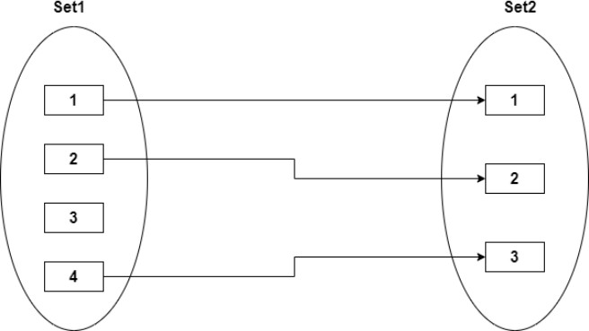
Types of Cardinality Mapping (One-to-One)
Another example is the relationship between the director of the school and the school because one school can have a maximum of one director, and one director can belong to only one school.
Note: it is not necessary that there would be a mapping fo all entities in an entity set in one-to-one cardinality.
Some entities cannot participate in the mapping.
r

Slide 7
In many to one cardinality mapping, from set 1, there can be multiple sets that can make relationships with a single entity of set 2.
Or we can also describe it as from set 2, and one entity can make a relationship with more than one entity of set 1.
One to one Cardinality is the subset of Many to one Cardinality.
It can be represented by M:1.
Types of Cardinality Mapping (Many-to-One)

Slide 8
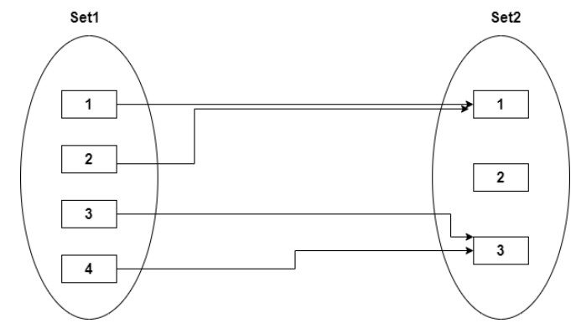
Types of Cardinality Mapping (Many-to-One)
For example, there are multiple patients in a hospital who are served by a single doctor, so the relationship between patients and doctors can be represented by Many to one Cardinality.

Slide 9
In One-to-many cardinality mapping, from set 1, there can be a maximum single set that can make relationships with a single or more than one entity of set 2.
Or we can also describe it as from set 2, more than one entity can make a relationship with only one entity of set 1.
One to one cardinality is the subset of One-to-many Cardinality.
It can be represented by 1: M.
Types of Cardinality Mapping (One-to-Many)

Slide 10
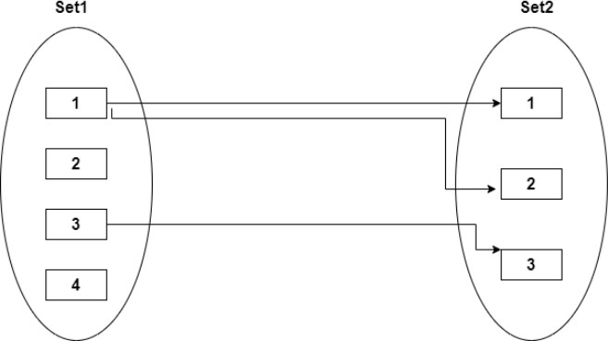
For Example, in a hospital, there can be various compounders, so the relationship between the hospital and compounders can be mapped through One-to-many Cardinality.
Types of Cardinality Mapping (One-to-Many)

Slide 11
In many-to-many cardinalities mapping, there can be one or more than one entity that can associate with one or more than one entity of set 2.
In the same way from the end of set 2, one or more than one entity can make a relation with one or more than one entity of set 1.
It is represented by M: N or N: M.
One to one cardinality, One to many cardinalities, and Many to one cardinality is the subset of the many to many cardinalities.
Types of Cardinality Mapping (Many-to-Many)

Slide 12
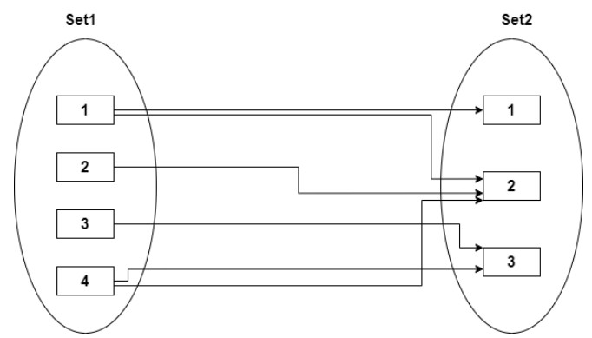
For Example, in a college, multiple students can work on a single project, and a single student can also work on multiple projects.
So, the relationship between the project and the student can be represented by many to many cardinalities.
Types of Cardinality Mapping (Many-to-Many)

Slide 13
Evidently, the real-world context in which the relation set is modeled determines the Appropriate Mapping Cardinality for a specific relation set.
We can combine relational tables with many involved tables if the Cardinality is one-to-many or many-to-one.
One entity can be combined with a relation table if it has a one-to-one relationship and total participation, and two entities can be combined with their relation to form a single table if both of them have total participation.
We cannot mix any two tables if the Cardinality is many-to-many.
Appropriate Mapping Cardinality

